Slide 1
iSpend
Presented for CSCE 485
Supervised by Dr. Mohamed Shalan
Winter 2021

Slide 2
What is iSpend?
Expense Management System
Users can track what kind of expenditures, savings and earnings they have made throughout the day
The application will be able to provide relevant data and aid the user in viewing what their financial behaviours look like

Slide 3







Application Flow
User Experience
Add New Entry
Add Entry Details
Add Receipt Picture (if any)
View Monthly/Weekly Data

Slide 4


Where are we now?
Application Back-End (Activities and classes)
Application Database
Application API
Receipt Scanning feature
Application Front-End (App design and layout)
Fully functional Application

Slide 5
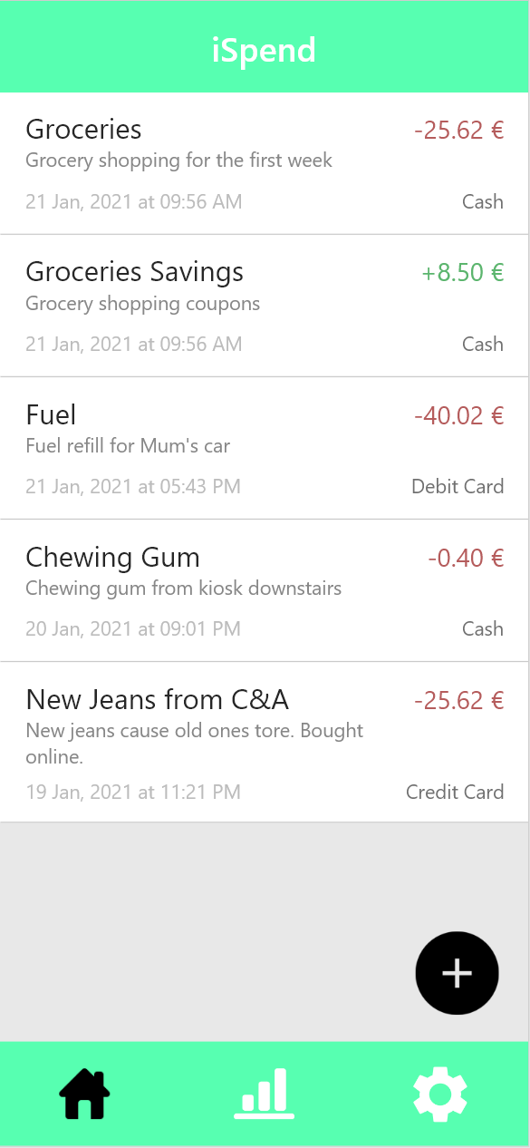
Application Back-End
Main RecyclerView
Main view
List of all the purchases made by the user on current day
Each entry can be edited and modified
Floating Action button for adding new entries

Slide 6
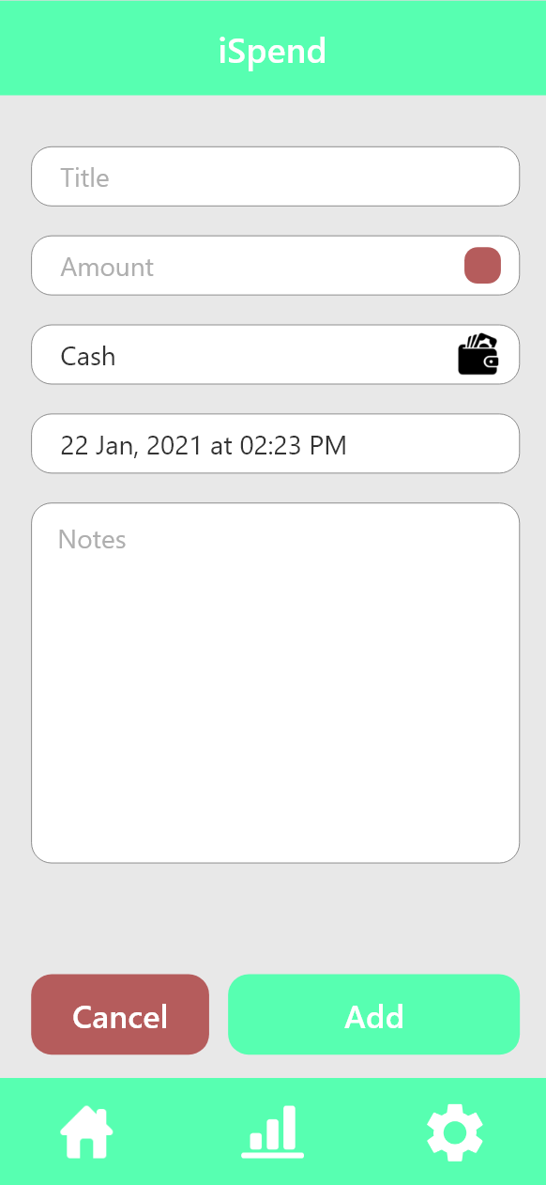
Application Back-End
Add Entry Activity
Add entry form
User adds all the necessary information about an entry such as title, amount spent or saved, time and date … etc.
User has the option to add any extra notes to the entry
The edit entries page is very similar in design and functionality

Slide 7
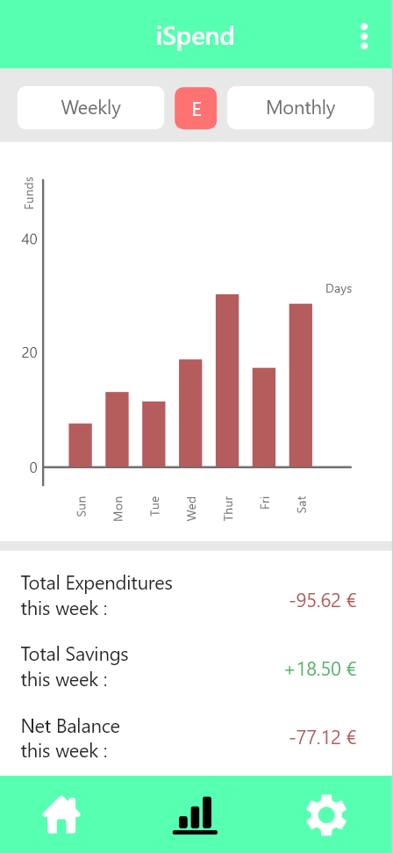
Application Back-End
View Statistics Activity
User can view all the relevant statistics related to their savings and expenditures for the last 7 days or 4 weeks
Library used : MPAndroidChart
User can view either expenditures or savings
Data for the last month or week can be viewed as well as total expenditures for those timeframes

Slide 8
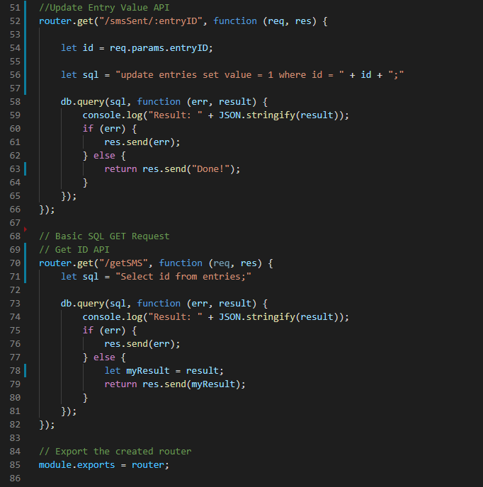
Application Database & API

Slide 9
Demo

Slide 10
Receipt
Scanning

Slide 11
Scanner Demo

Slide 12
What’s missing?
Application Front-End (App design and layout)
Fully functional Application

Slide 13
Thank You!
Presented by Mohamed Bedda, Abdelrahman Ahmed, Mohamed Tarek & Saif El Din Abbas

